Slide 1
A Survey of Generative Adversarial Neural Networks (GAN) for Text-to-Image Synthesis
Mirsaeid Abolghasemi
San Jose State University
Spring 2020

Slide 2
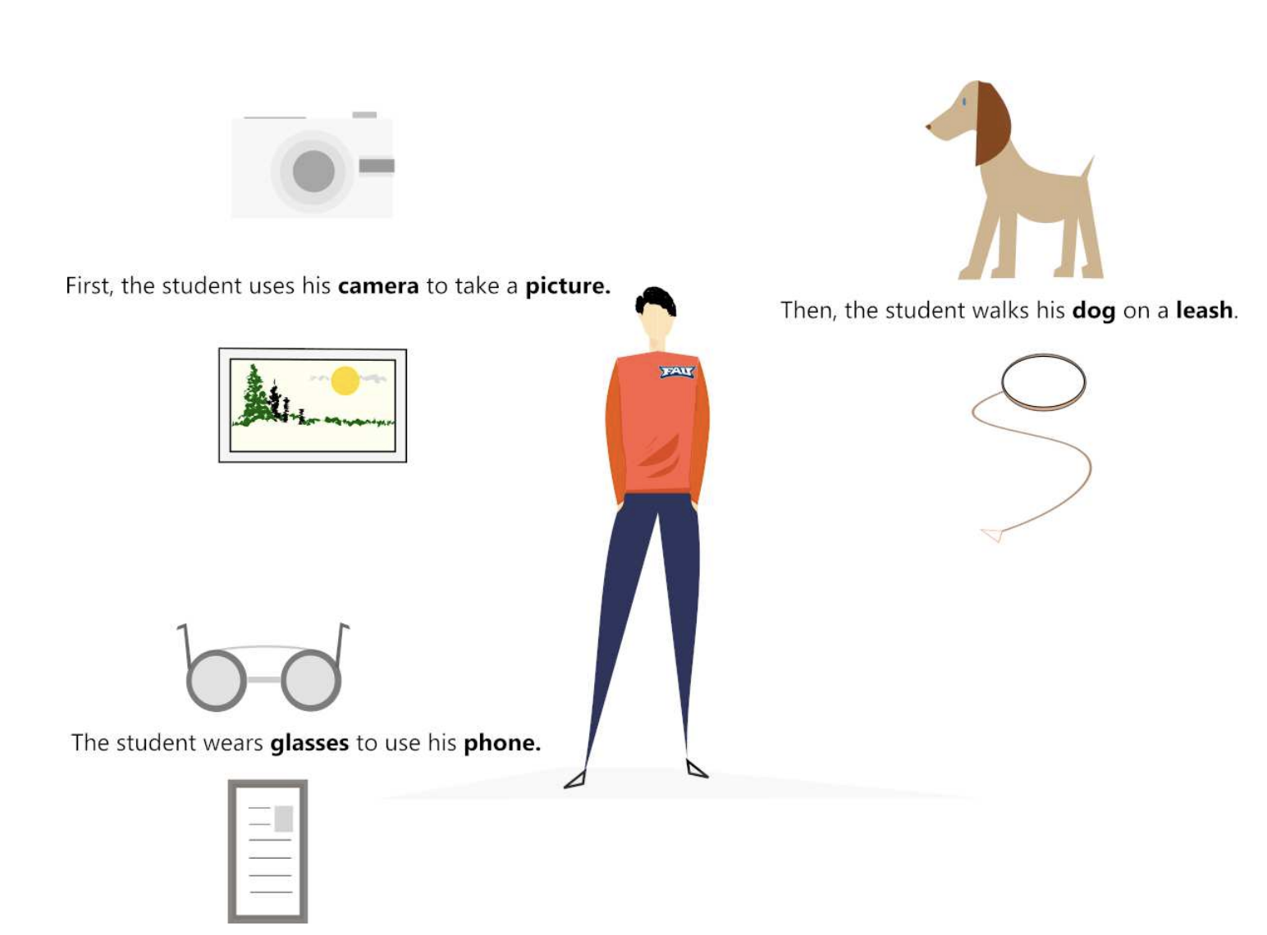
1 Introduction
1.1 Traditional Learning-Based Text-to-image Synthesis
Recent research into the conversion of text to picture (Zhu et al., 2007).
The program uses the similarity between keywords (or keyphrases) and images and recognizes descriptive and "pictureable" text objects
then looks for the most possible text-conditioned image pieces, and
eventually optimizes the text-conditioned image structure as well as the image sections.

Slide 3
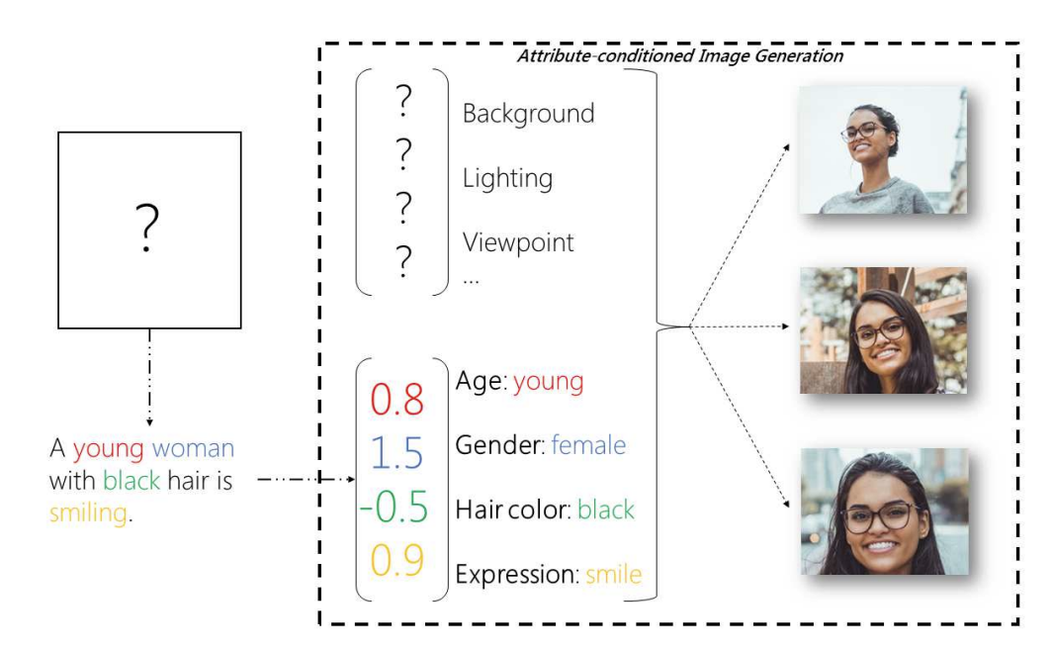
1.1 Traditional Learning-Based Text-to-image Synthesis (Cont.)
Supervised learning based text-to-image synthesis

Slide 4
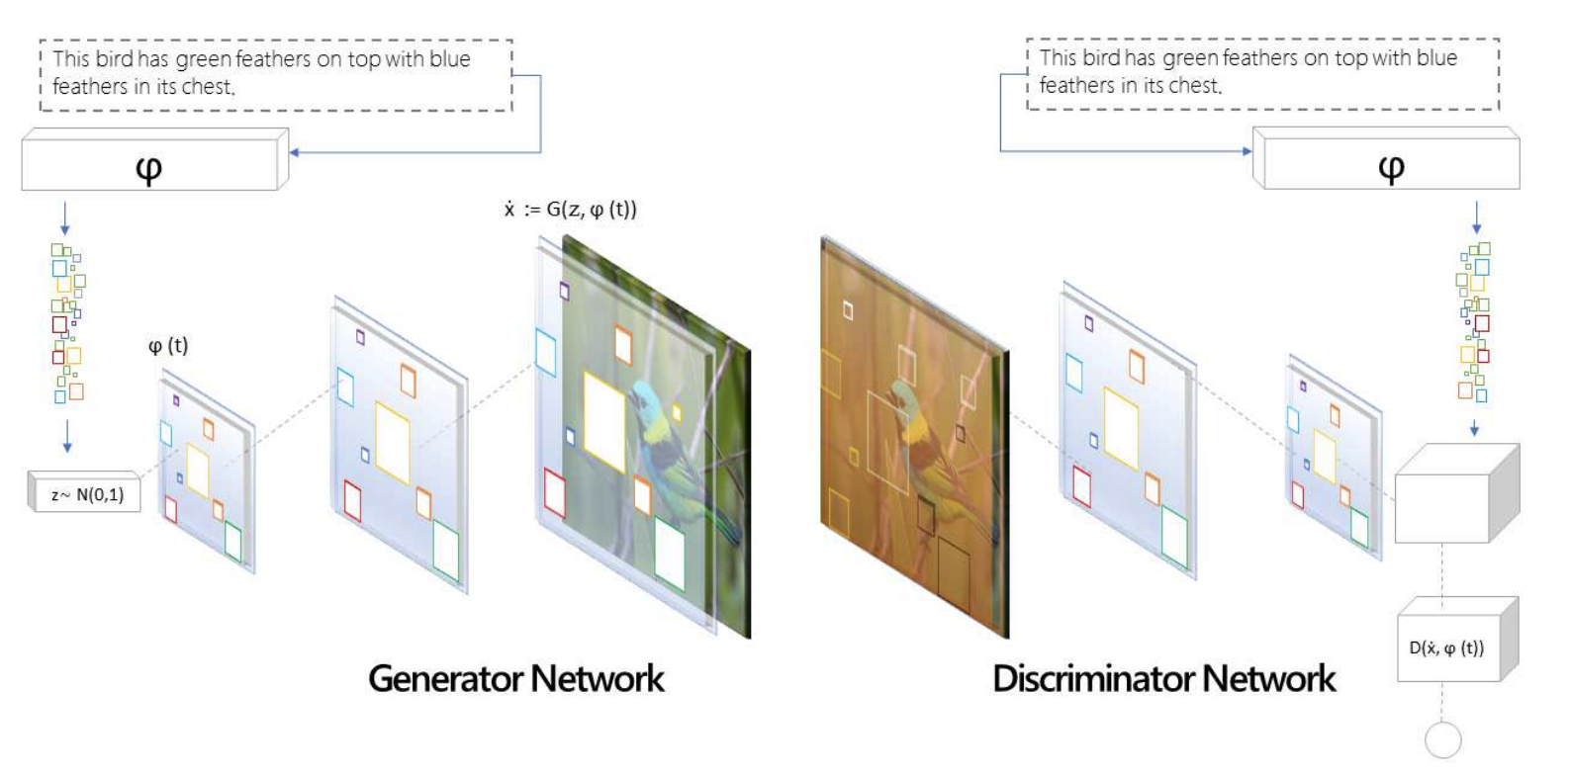
1.2 GAN Based Text-to-image Synthesis
A text-to-image synthesis based on the generative adversarial neural network (GAN) (Huang et al. 2018).
GAN-based text-to-image synthesis incorporates discriminative and generative learning to train neural networks outputting in pictures
being semantically similar to the training samples or matched to a subset of training photos

Slide 5
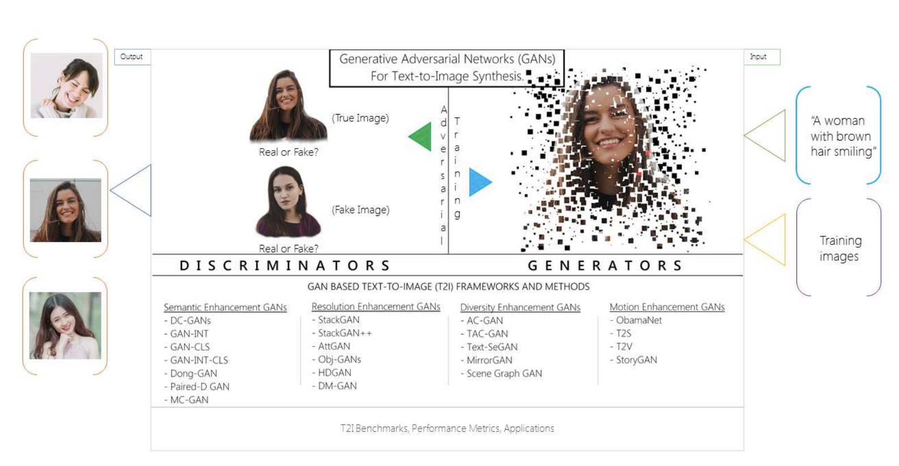
1.2 GAN Based Text-to-image Synthesis(Cont.)
A graphic overview of the GAN-based text-to-image (T2I) synthesis process and
the survey description of GAN-based frameworks/methods.

Slide 6
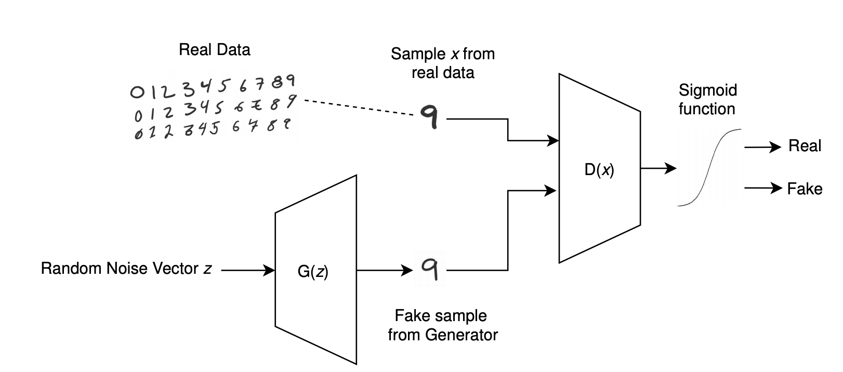
2 FRAMEWORKS
2.1 Generative Adversarial Neural Network
A computational interpretation of the Framework of the Generative Adversarial Network (GAN).
Generator G(z) is equipped, from a random noise distribution, to produce synthetic/fake resemblance to actual samples.
The real and fake samples are fed together to the Discriminator D(x)
The Discriminator is qualified to differentiate counterfeit samples from real data.

Slide 7
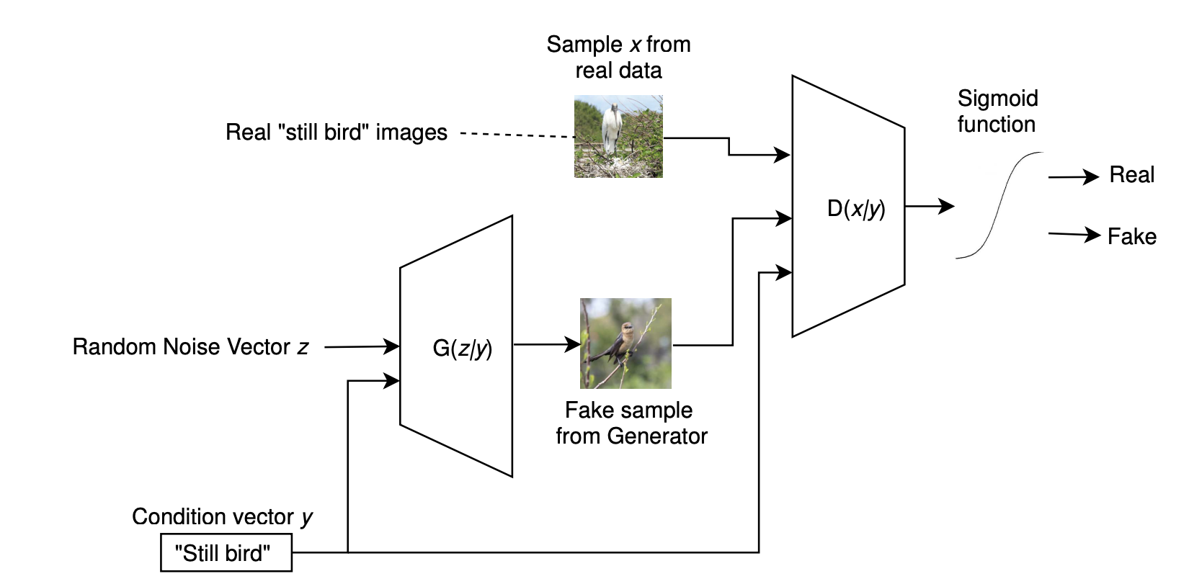
2.2 cGAN: Conditional GAN
Functional overview of the conditional GAN
Generator G(z) produces samples and several condition vector (in this case text) by a random noise distribution.
The fake inputs are passed to Discriminator D(x) together with real data and a similar condition vector, and
The Discriminator measures the probability that the fake input resulted from the real data distribution of the results.

Slide 8
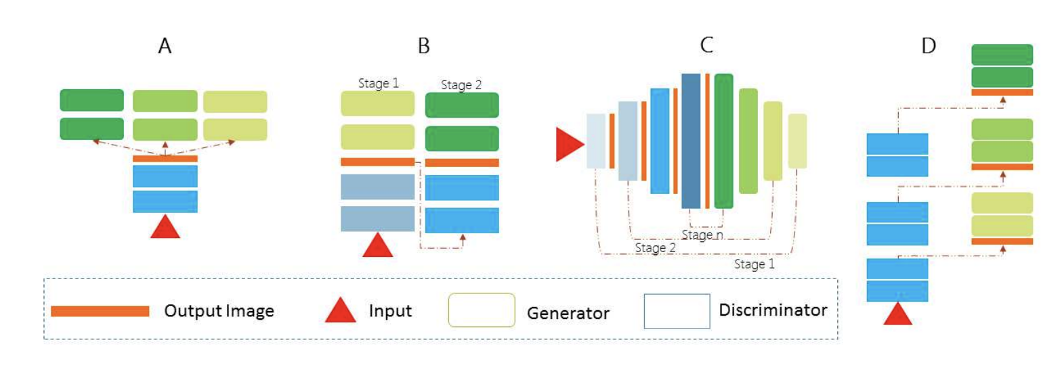
2.3 Advanced GAN Frameworks for Text-to-Image Synthesis
A high-level comparison of several advanced GANs framework for text-to-image synthesis.
All frameworks take text (red triangle) as input and generate output images.
(A) uses multiple discriminators and one generator
(B) uses multiple-stage GANs where the output from one GAN is fed to the next GAN as input
(C) progressively trains symmetric discriminators and generators
(D) uses a single-stream generator with a hierarchically-nested discriminator trained from end-to-end

Slide 9
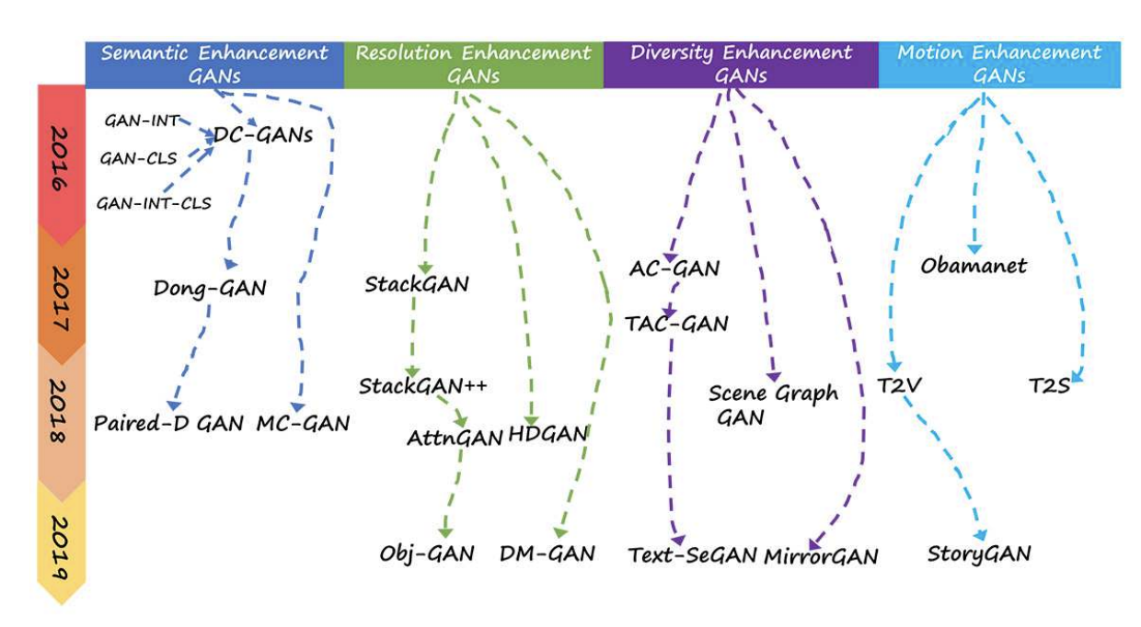
3 CATEGORIZATION of TEXT-TO-IMAGE SYNTHESIS
The GAN frameworks are categorized into four major groups:
Semantic Enhancement GANs
Resolution Enhancement GANs
Diversity Enhancement GANs
Motion Enhancement GAGs

Slide 10
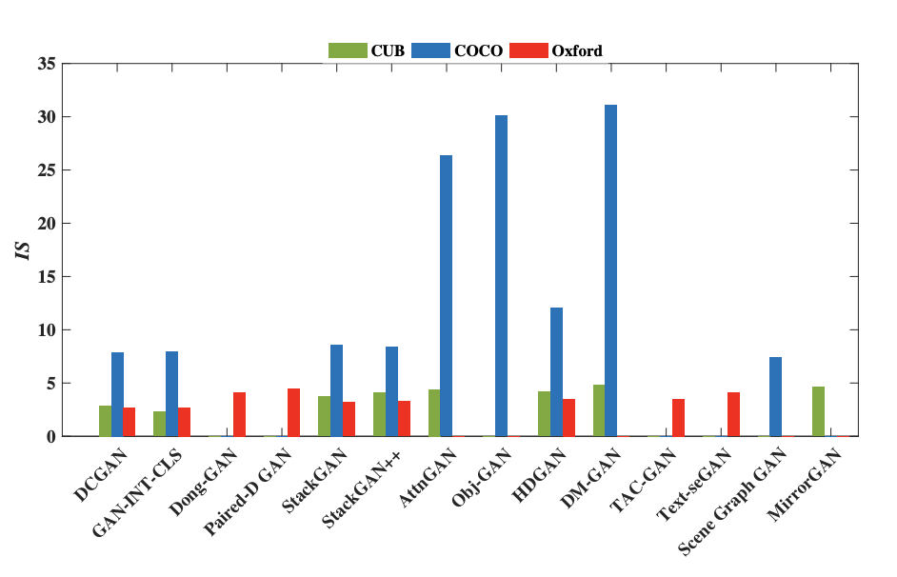
4 GAN Based Text-to-image Synthesis Results Comparison
Performance comparison between 14 GANs with respect to their Inception Scores (IS).

Slide 11
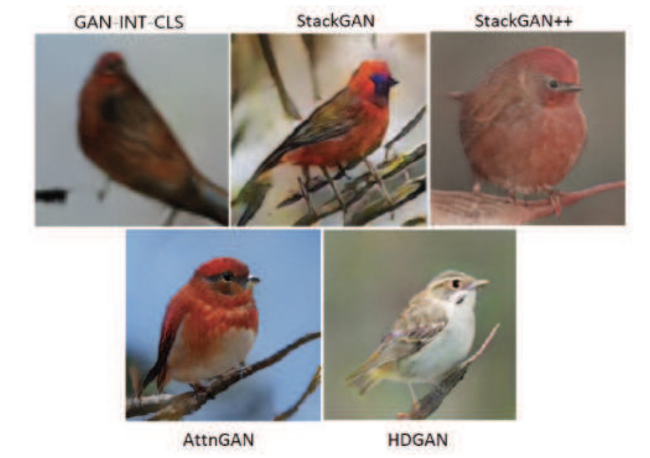
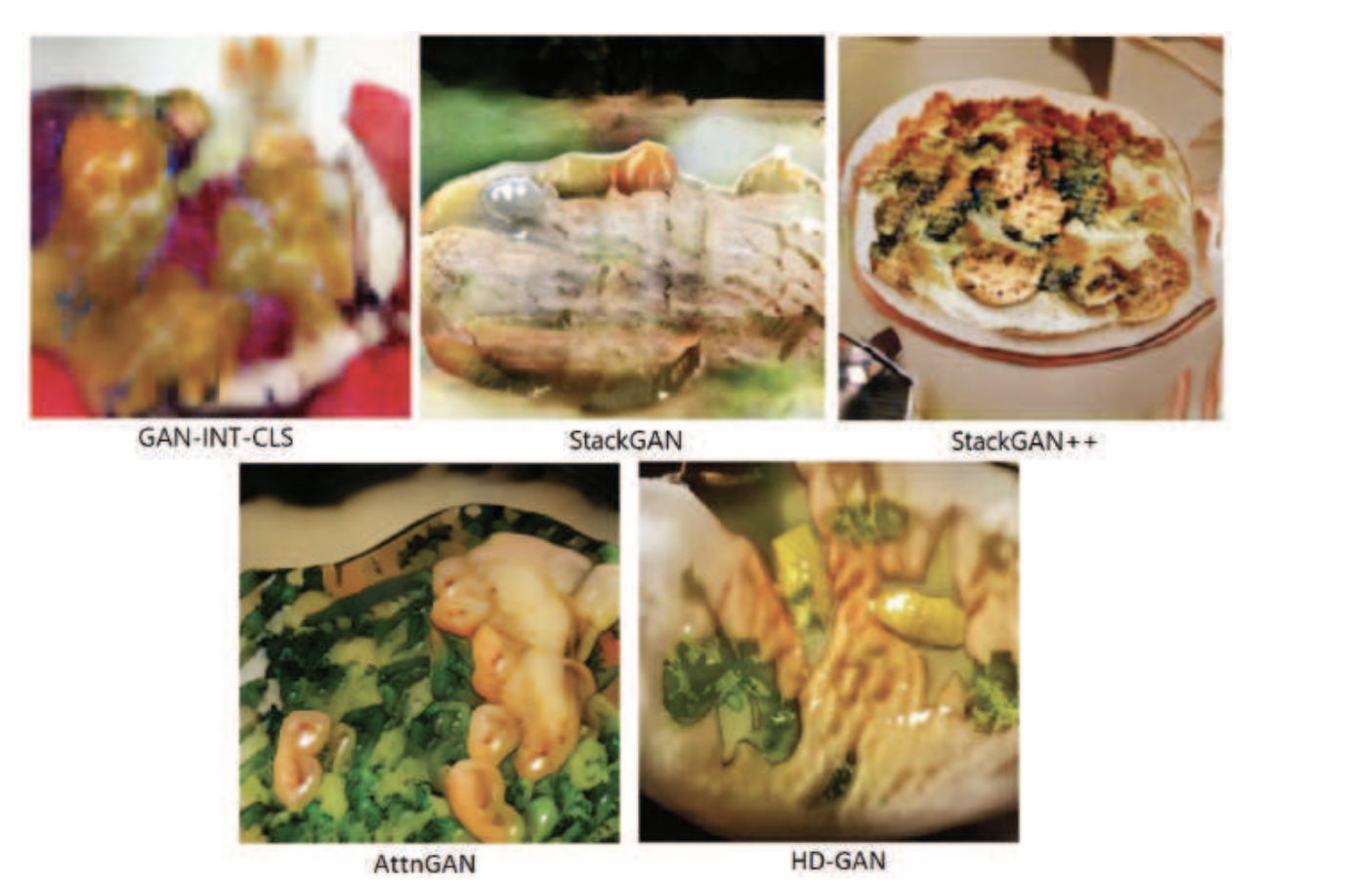
4 GAN Based Text-to-image Synthesis Results Comparison(Cont.)
Some best images of “birds” and “a plate of vegetables” generated by GAN-INT-CLS, StackGAN, StackGAN++, AttnGAN, and HDGAN.

Slide 12
5 CONCLUSION
The latest progress in the study of text-to-image synthesis provides various persuasive techniques and algorithms.
At first, the primary goal of text-to-image synthesis was to generate images from simple texts, and
that goal later adjusted to natural languages.
In this survey, new techniques were explained which can create the best visual and image-realistic pictures from text-based natural language.
The pictures created usually based on
adversarial generative networks (GANs),
deep convolutional decoder networks, and
multimodal learning methods.
These techniques will be outstandingly expanded in the near future.
Making less human interaction and maximizing the scale of the generated images can be impressive improvements in the future.

Slide 13
Reference:
This article is a summary of the following paper:
Jorge Agnese and Jonathan Herrera and Haicheng Tao and Xingquan Zhu, “A Survey and Taxonomy of Adversarial Neural Networks for Text-to-Image Synthesis”, arXiv, 2019.

